Slide 1
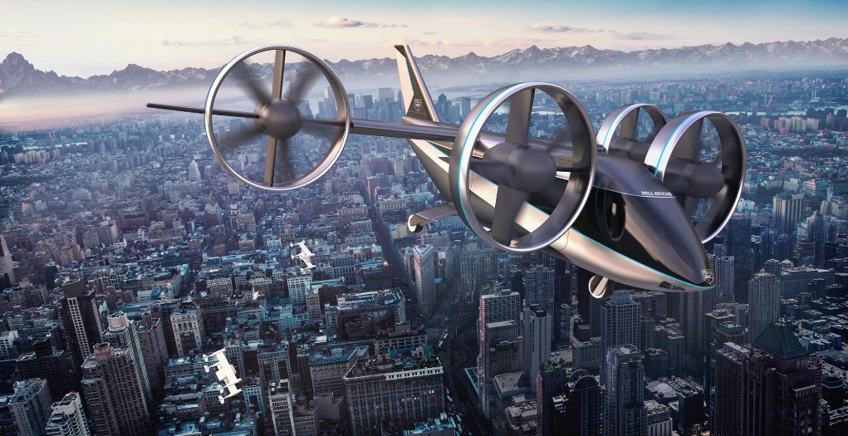
eVTOL Flying Testbed
Sam Drury
03/12/2020
Supervisor:
Dr Sam Grimshaw
https://www.bellflight.com/products/bell-nexus
Whittle Laboratory
Notes:
Hi everyone, this afternoon I’ll be taking you through my project focusing on an electrical Vertical Take-off and Landing, eVTOL Flying Testbed.
(click)
The eVTOL market is one of the great emerging technologies of today, bringing shorter commuting times at an affordable price, with vehicles powered by zero emission local electric power.

Slide 2
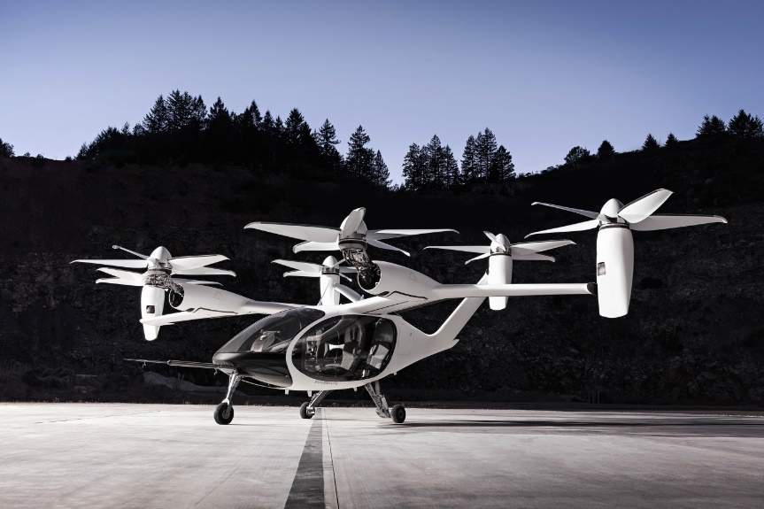
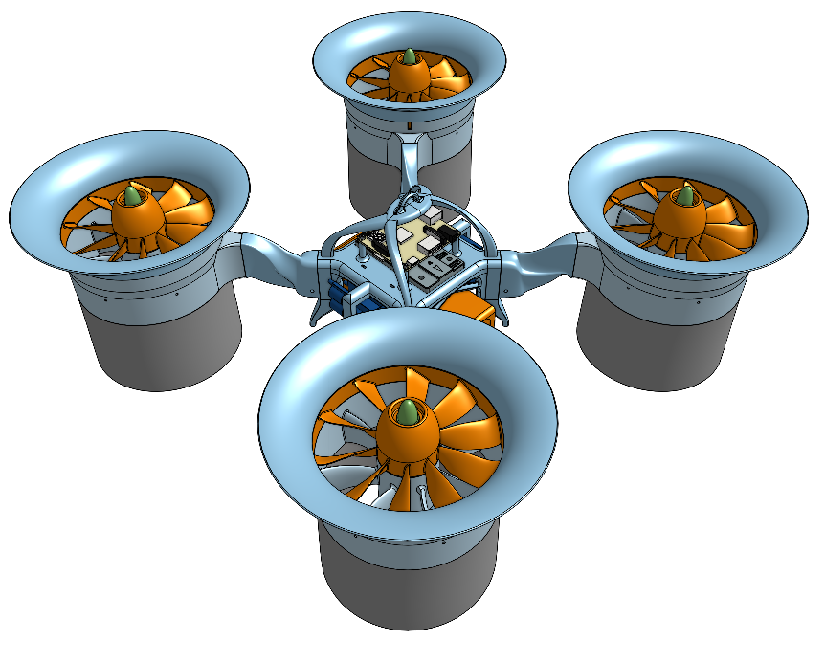
Benefits of Ducted Fans vs Propellors
https://www.jobyaviation.com
Ducted Fans can improve hovering performance compared to propellors while being safer and quieter
Notes:
There is a choice to be made when selecting propulsors. While the simplicity of propellers make them an attractive option, the hovering performance and efficiency can be increased by using ducted fans, which has been confirmed through previous work. Additionally, the shrouding around the fans reduces the noise and brings an added safety benefit by shielding the rotors.

Slide 3
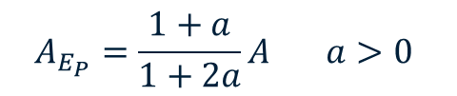
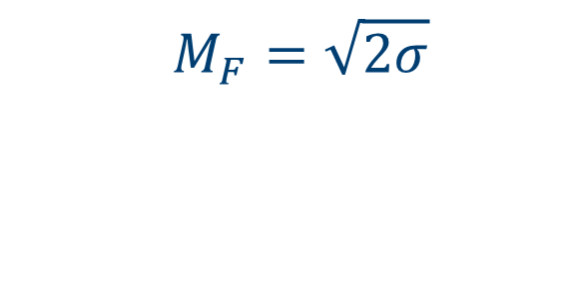
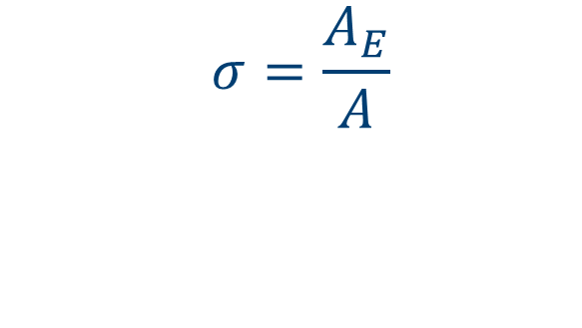

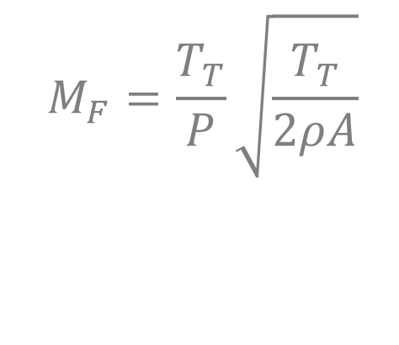

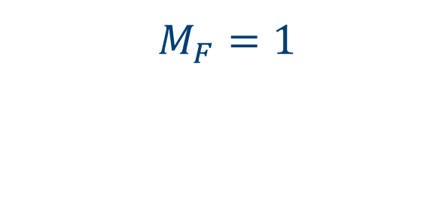
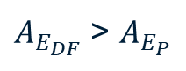
Devising a Suitable Performance Metric
$$M_{F}=\frac{T_{T}}{P}\sqrt{\frac{T_{T}}{2ρA}}$$
$$A$$
$$A$$
$A_{E_{DF}}$ > $A_{E_{P}}$
$$M_{F}=\sqrt{2σ}$$
$$A_{E_{P}}=\frac{1+a}{1+2a}A a>0$$
$$σ=\frac{A_{E}}{A}$$
$$M_{F}=1$$
Notes:
Since the propulsive efficiency for hover would be zero, a different expression is required to quantify the performance of different propulsor designs.
Researcher named Pereira developed this expression, which I’ll refer to as the Figure of Merit. For propellors, this is equal to the ratio of ideal to actual power, hence the maximum is unity. In reality, the flow streamtube contracts downstream, and there is no control on the jet area.
CLICK
However, simple 1D CV analysis for a ducted fan shows Mf to be root 2 sigma, where sigma is defined as the exit duct area ratio shown, and provided this is kept greater than 0.5, ducted fans will outperform propellors.

Slide 4
Project Aims
Ducted Fan design for hover
Characterising Ducted Fan
Develop flying testbed
In-flight measurements
Control
Notes:
So here are the aims of my project thus far, and I’ll be discussing each in turn, beginning with designing a ducted fan optimised for hover, then characterising the fan on a static test rig, and finally building up to developing a VTOL drone with initially 4 propulsors where I can take in-flight measurements and look at the control of the flying testbed.

Slide 5
Design Methods
Assumptions
Isentropic, incompressible flow
No inlet/exit swirl
1D design
SFME, SFEE
2D design
Radial equilibrium
Mixed vortex
Sweep & lean
Design Process
Inputs
Φ, σ, Thrust, Geometry
Axial velocity
Blade speed
Velocity Triangles
Chord distribution
Blade angles
Number of blades
Notes:
Initially assume …, low speed, … purely axial flow at inlet and exit – swirl removed by stator blades
From inputs, use …, then use Euler work with radial equilibrium to develop a mixed vortex design, and finally incorporate lean and sweep.
CLICK
This flowchart summarises the design process, from the inputs through to the full blade designs, where the inputs are ….

Slide 6
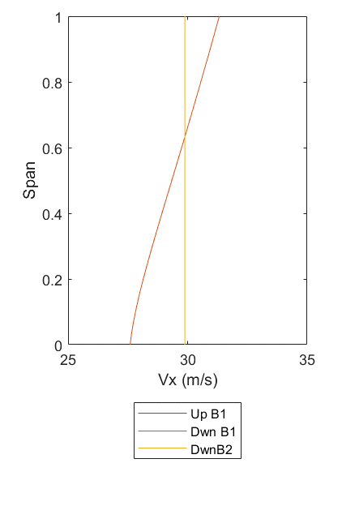
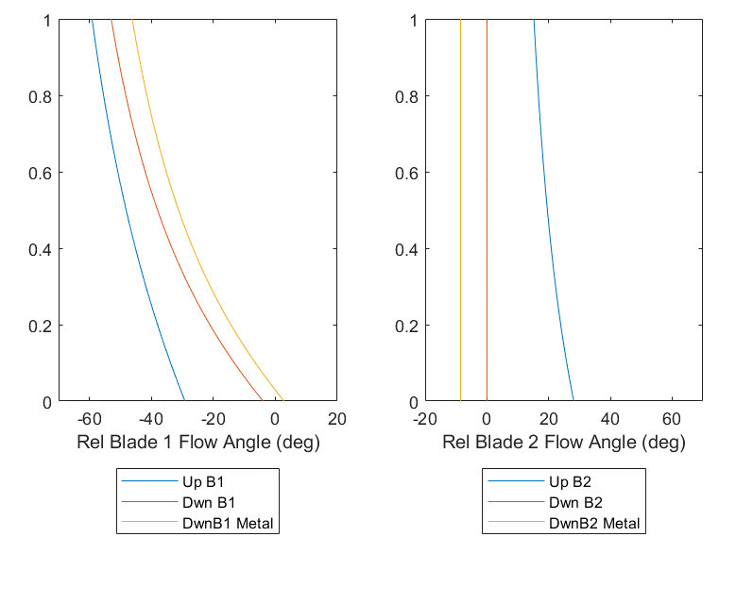
Generating Velocities and Flow Angles
Use Lieblein correlation to set mean-line chord
Use Carter’s empirical relation to set blade metal angles
Notes:
Once Vx determined from SFME, mixed vortex design yields the distribution of Vx either side of mean line shown here, orange downstream of rotor
Second graph rotor Flow angles, blue upstream and orange downstream determined from the stage loading.
Lieblein’s correlation for diffusion factor sets mean-line chord, which is used in Carter’s emp.relation to determine the meanline deviation. This deviation is then set as a constant across the span, shown here
Finally, stator angles shown, where the flow angle (orange) is purely axial across the span (no exit swirl)
Take graph 2, rotor, with me,

Slide 7
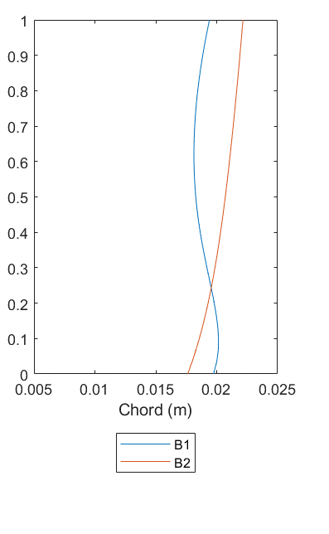
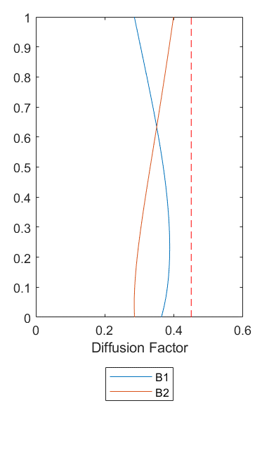
Generating Chord and Diffusion Factor Distributions
Carter’s relation recalculates chord distribution
Lieblein correlation recalculates diffusion factor
Notes:
The chord at meanline was used to determine the deviation, so working backwards I now calculate the chord distribution across the span that gives a constant deviation, using Carter’s rule again, which is also a function of flow turning, and this varies across the span, shown
Using the chord distribution, the diffusion factor distribution is determined using Liebleins correlation, and the graph shows this to be less than a predetermined threshold, so minimises the risk of stall.

Slide 8
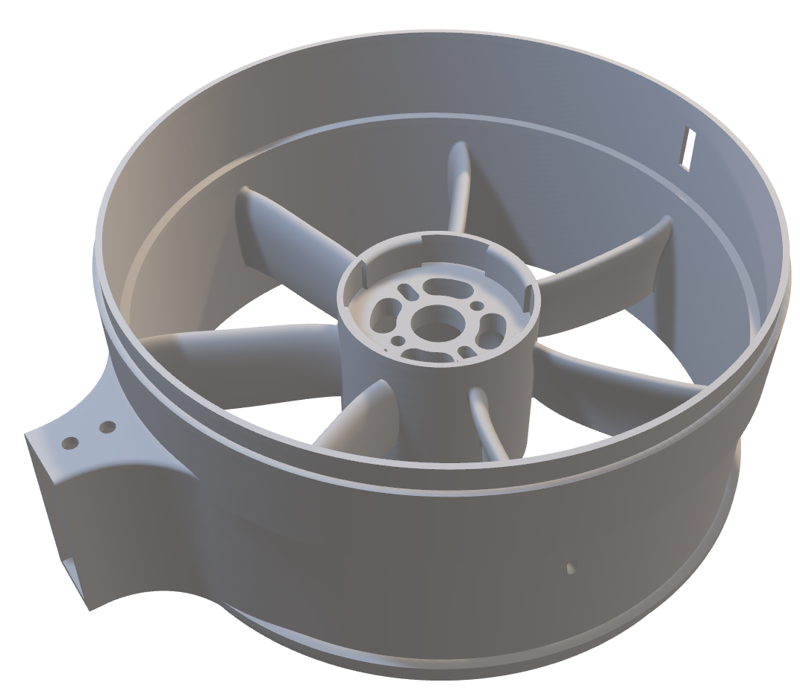
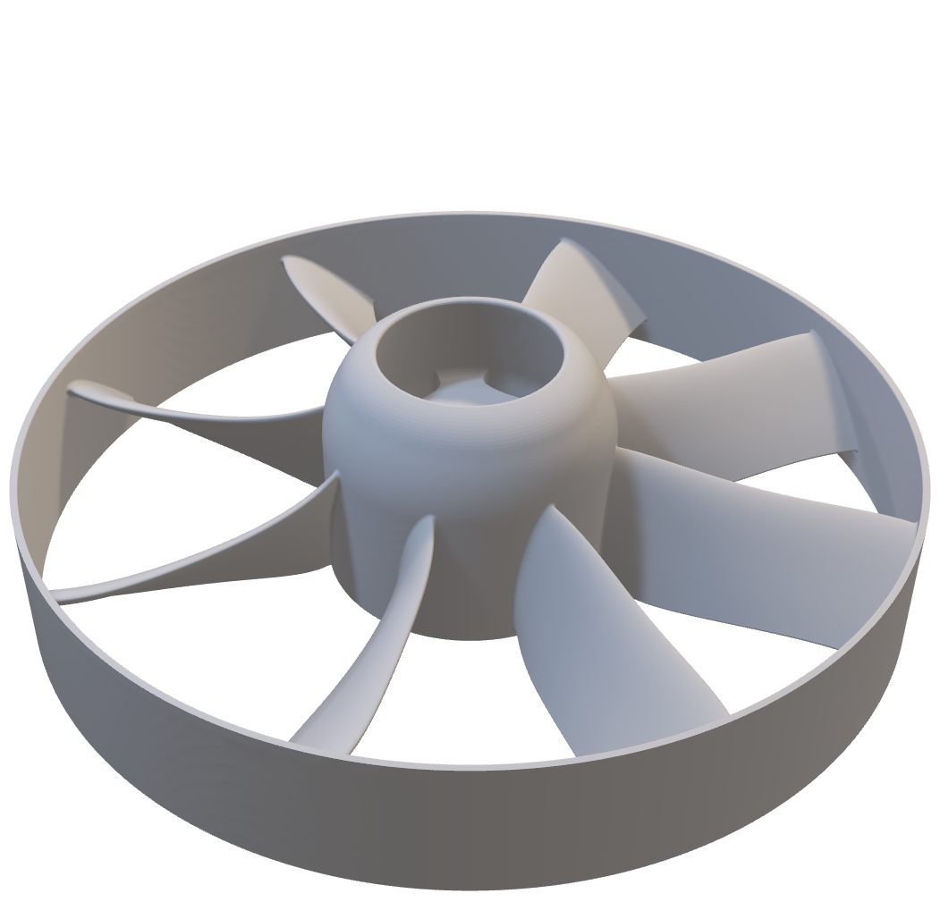
Chosen Design
N_{rotor} = 8
N_{stator} = 7
Sweep & Lean
Adding sweep and lean minimizes end-wall losses, and extends operating range through limiting separation
(Taylor & Miller)
Notes:
The blade numbers are shown here – determined from the chord, DF, then pitch all at the mean line
These components, as well as the inlet/exit ducts, Manufactured using Ultimaker 3D Printers.
I’ve tuned the printers to accommodate delicate features such as the thin trailing edges. Also I have smoothed the suction surface after printing, ensure no trip wires that may entice separation in critical areas
Looking at stator, can see where motor mounts, holes for cables and air flow to ensure no overheating
Motor powered through wires passing through stator blades
(RPM slot, reflective tape on rotor and IR sensor calculates RPM)
CLICK
Here I’ve highlighted where I have incorporated sweep and lean, to minimize end-wall losses and enhance off-design stability, where the incidence isn’t zero
The work done on 3D dimensional flows through blade passages by Taylor, who is co-supervising the eVTOL projects, and Miller has enabled me to select suitable values of sweep and lean

Slide 9
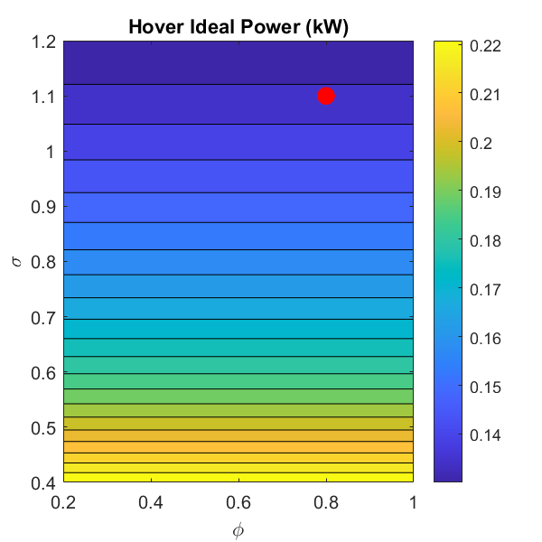
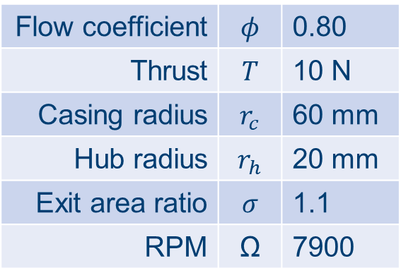
Chosen Design
Flow coefficient | $$φ$$ | 0.80
Thrust | $$T$$ | 10 N
Casing radius | $$r_{c}$$ | 60 mm
Hub radius | $$r_{h}$$ | 20 mm
Exit area ratio | $$σ$$ | 1.1
RPM | Ω | 7900
Notes:
Table on left summarises design input parameters, and the motor speed, rpm, required for a thrust of 10N.
Contour plot on right shows how the power required to hover is invariant to phi but depends on the exit area ratio sigma, so to minimize power and maximise Mf, I selected a higher value.
The motors used have a speed rating, so keeping the RPM at a sensible value requires a higher value of flow coefficient
Design point shown in red
(De Haller number = 0.85 Stall limit = 0.72)

Slide 10
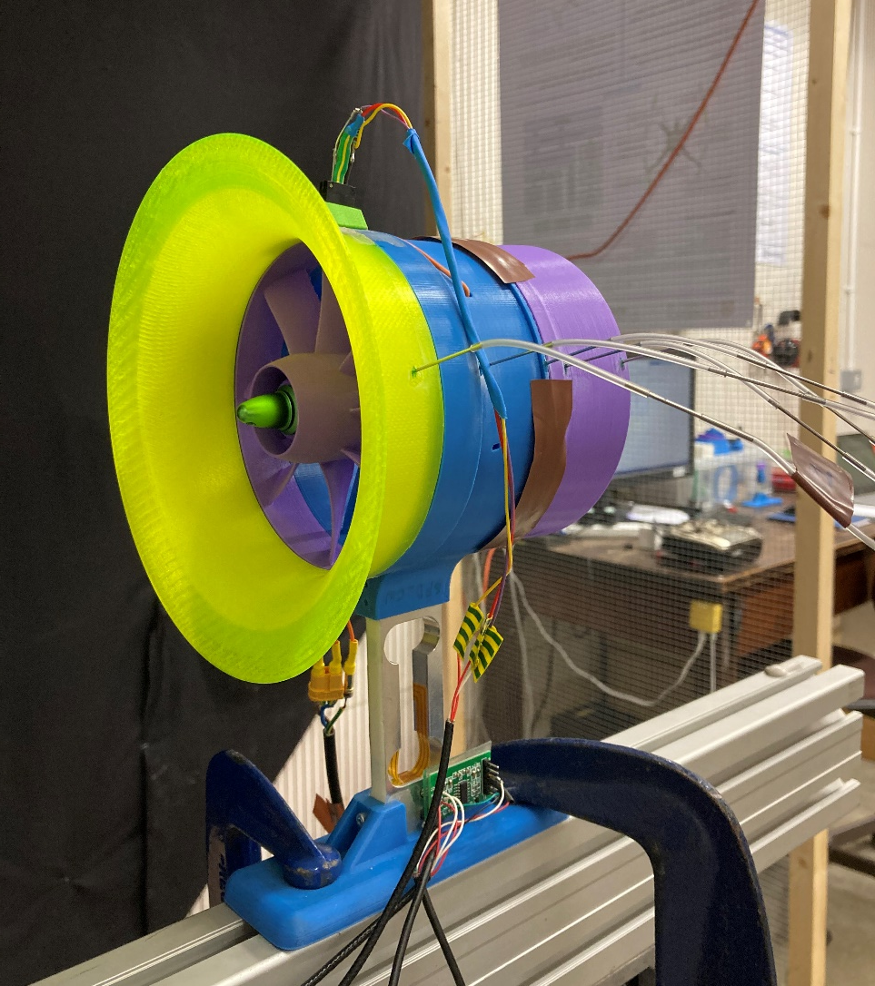
Measuring RPM, Power, Pressure, Thrust
RPM Sensor
Pressure Tappings
Motor Power Supply
Loadcell & Amplifier
Notes:
This image helps to Visualise static test setup
Highlight features I’ll go through

Slide 11
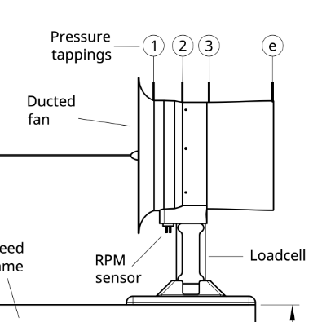
RPM Measurement
Data Collection
Raspberry Pi
SSH over WiFi
RPM
IR Sensor
Notes:
IR sensor connected to RPi on board drone chassis, Python script collects data, exported over WiFi

Slide 12
Power Measurement
Data Collection
QGroundControl
Telemetry
Power
Notes:
QGroundControl software interfaces through radio telemetry with the onboard flight controller
,so power consumed is determined from system voltage and current

Slide 13
Pressure Measurement
Data Collection
DSA Pressure Transducer
Ethernet
DSA
Notes:
Static pressure tappings on casing connected to DSA, and these measurements accessed through an ethernet cable

Slide 14
Thrust Measurement
Data Collection
Raspberry Pi
SSH over WiFi
Thrust
Shear Loadcell
Notes:
Similar to the RPM, a python script measures the thrust through a calibrated loadcell, and the data is exported over wifi

Slide 15
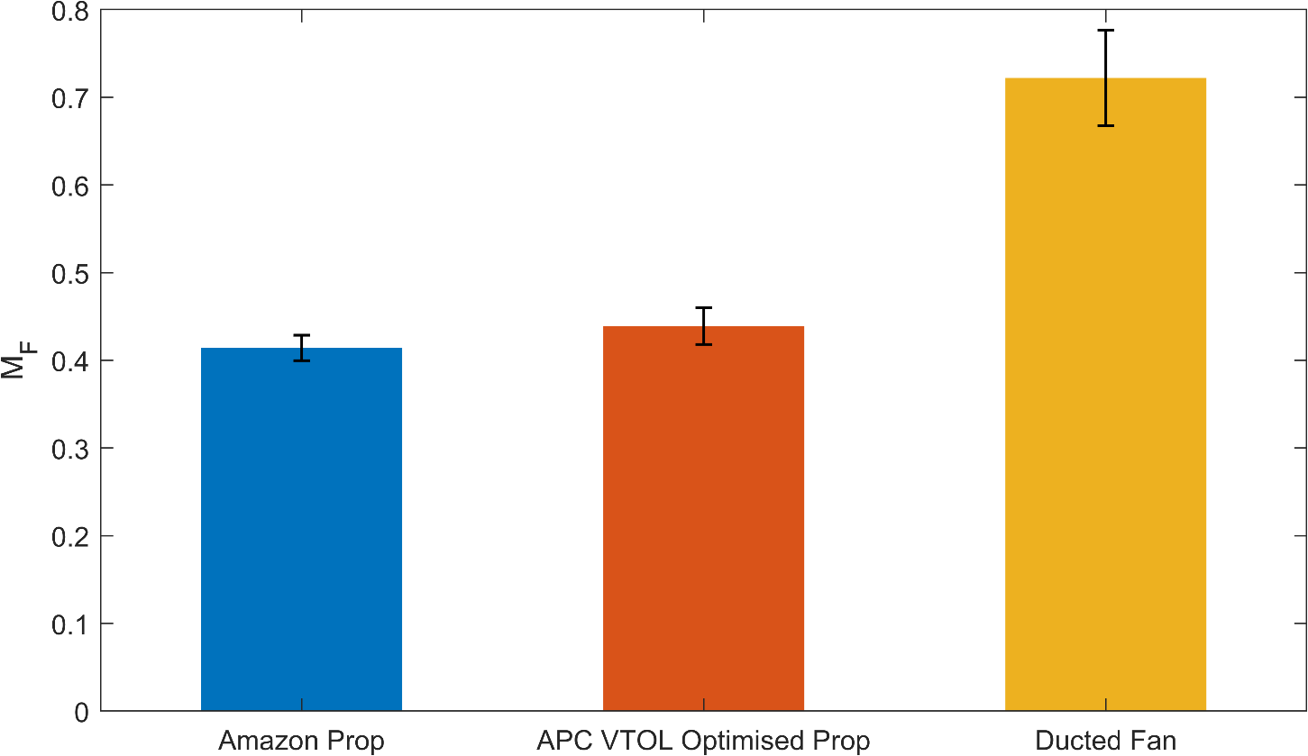
Validating Ducted Fans against Propellors
Ducted fan yields 64% increase in Figure of Merit
Notes:
Using the static test stand, the figure of merit is compared between the ducted fan, a cheap propellor and a higher performance propellor. This graph clearly shows that ducted fans do indeed have a larger figure of merit, 64% greater than the high performance prop. The error bars represent the stdev of test results which were taken at different motor speeds.

Slide 16
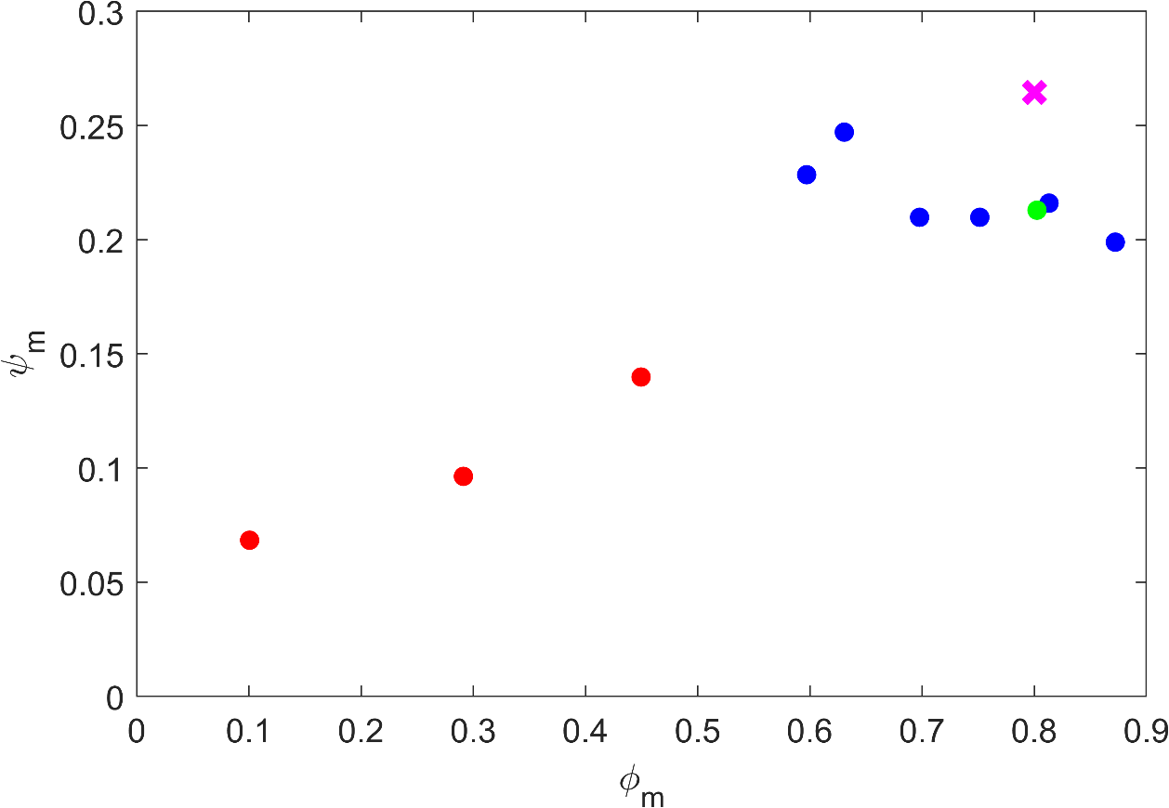
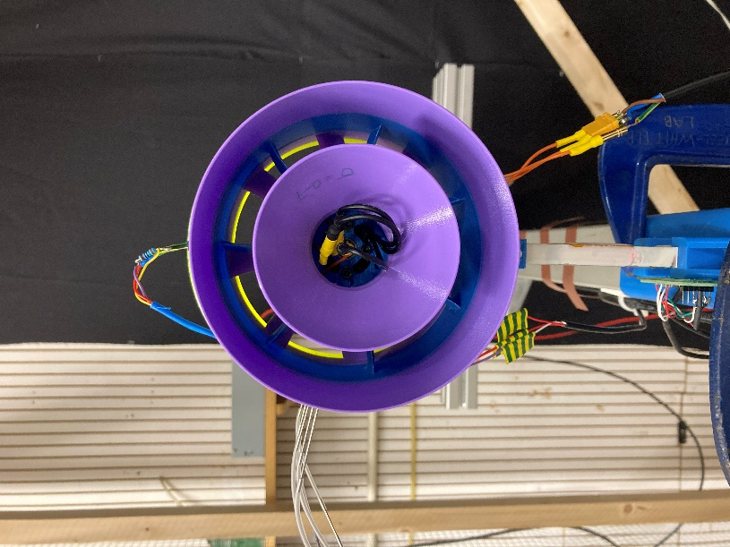
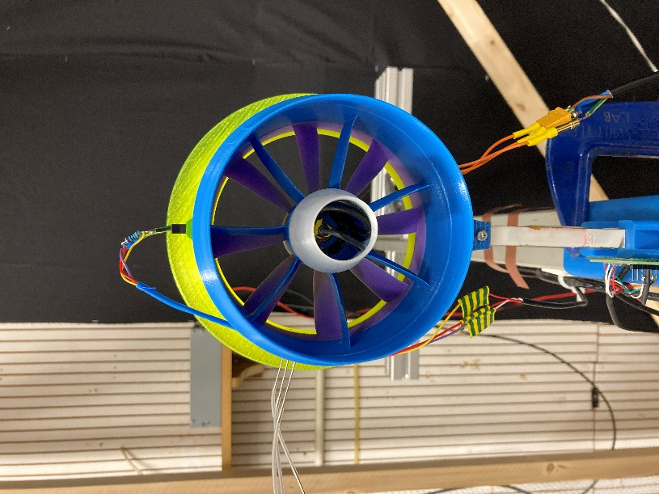
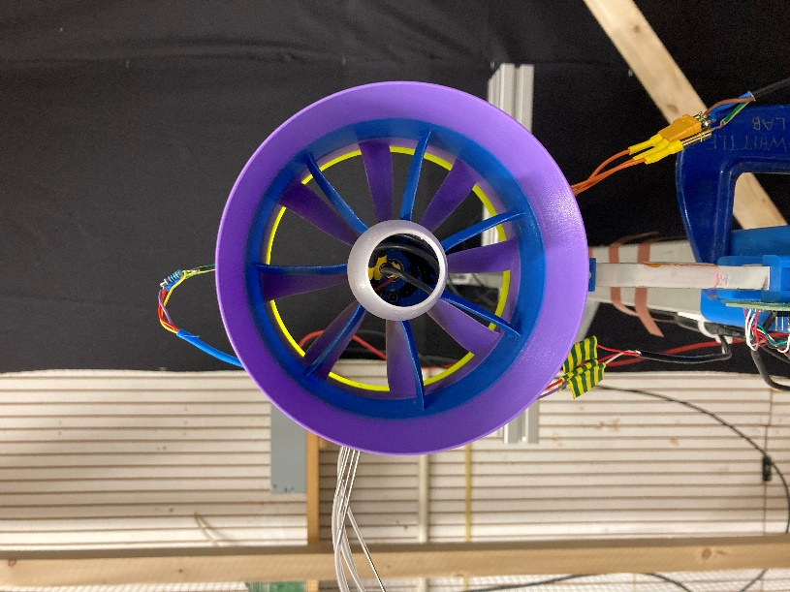
Obtaining Ducted Fan Characteristic by Varying σ
Notes:
ND axial velocity, flow coef vs ND pressure rise, stage loading
These are mean-line values` (using vortex exponent to relate casing to meanline)
To obtain this dataset, I’ve varied the operating point through varying exit area ratio sigma
Expected trend is visualised
HIGHLIGHT THREE POINTS
Design value
Reduced sigma, less mass flow, greater ND pressure rise
Limit to decreasing sigma – fan stalls, pressure rise much lower
Stall points shown in red
Mention forward velocity
Design point is in pink
Phi less than ideal at design, but in line with phi, and not on the limit of stall ☺
Hope to build on this by ‘opening the throttle’, and also overlaying efficiency contours
(click)
Assumptions – isentropic flow
Sweep and lean minimise, not eradicate
Manufacturing defects
I plan to build on this, ‘open the throttle’ by having a fan upstream to increase mass flow
(efficiency plot as well)

Slide 17
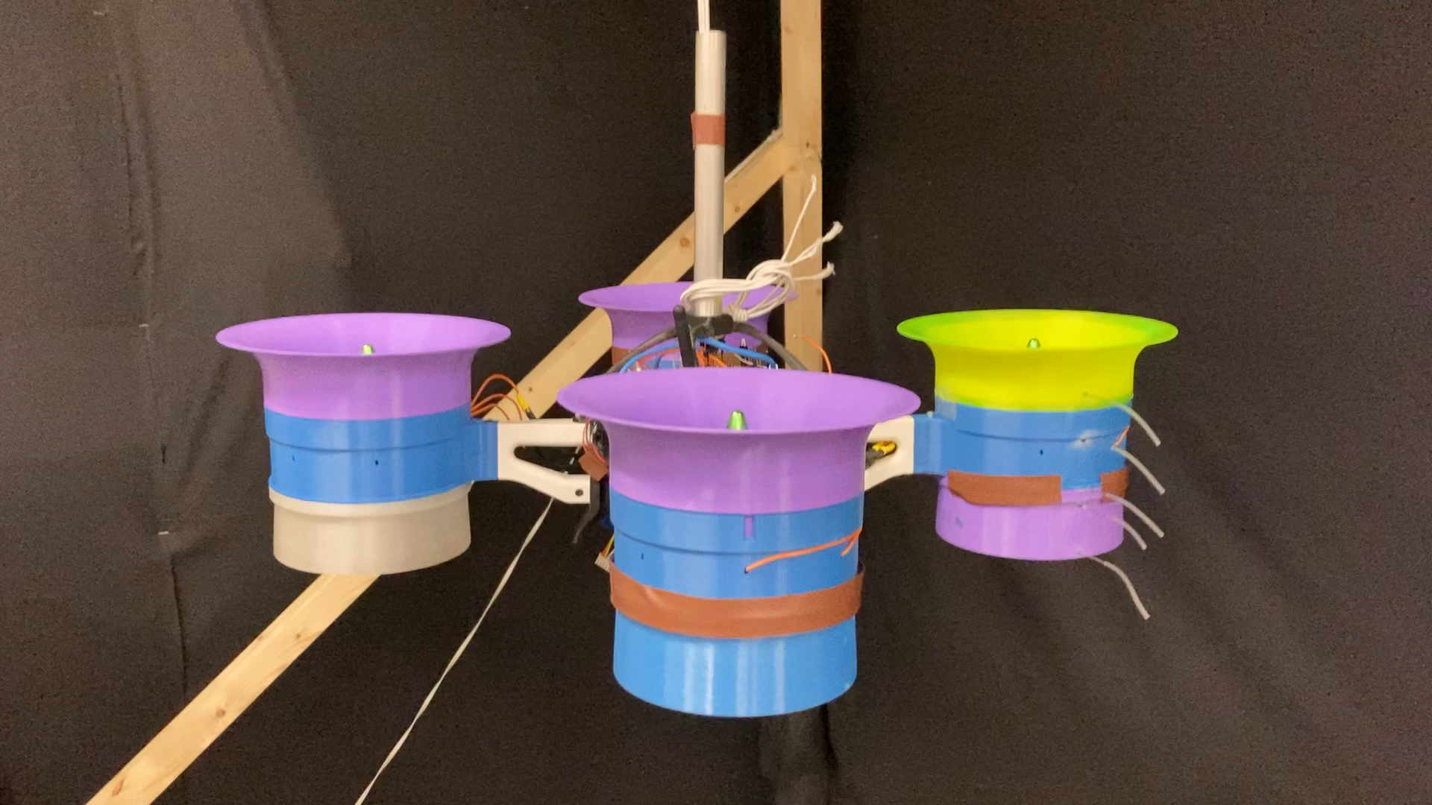
Inaugural Whittle Lab Test Flight!!
Notes:
And now, I present you the inaugural whittle lab test flight
Other than proving the need for the safety cage
I will now have the Ability to Remotely measure power, RPM, pressures, stability

Slide 18
Summary
So far:
Designed and manufactured 4x Electric Ducted Fans (EDFs)
Proved a 64% increase in FOM for EDFs compared to propellors
Preliminary measured characteristic for the EDF confirms design point operation and stall margin
Developed a flying testbed
Going forward:
Continue to improve testbed and use next term
Develop existing EDF design according to work by Jonathan Collins
Notes:
To conclude:
I’ve worked to produce a eVTOL quad with ducted fans that outperforms propellors
Conducted initial experiments to characterise the fan, and can validate the design theory, as well as showing there is a margin in the operating point before the fan stalls
Developed a flying testbed
CLICK
The testbed, as we have seen, needs refinement to ensure measurements can be taken accurately and reliably
Using the work by Jon Collins, I will be able to refine my EDF design to further improve the figure of merit
THANK YOU, welcome any questions you may have

Slide 19
eVTOL Flying Testbed
Sam Drury
03/12/2020
Supervisor:
Dr Sam Grimshaw
https://www.bellflight.com/products/bell-nexus
Whittle Laboratory

Slide 21
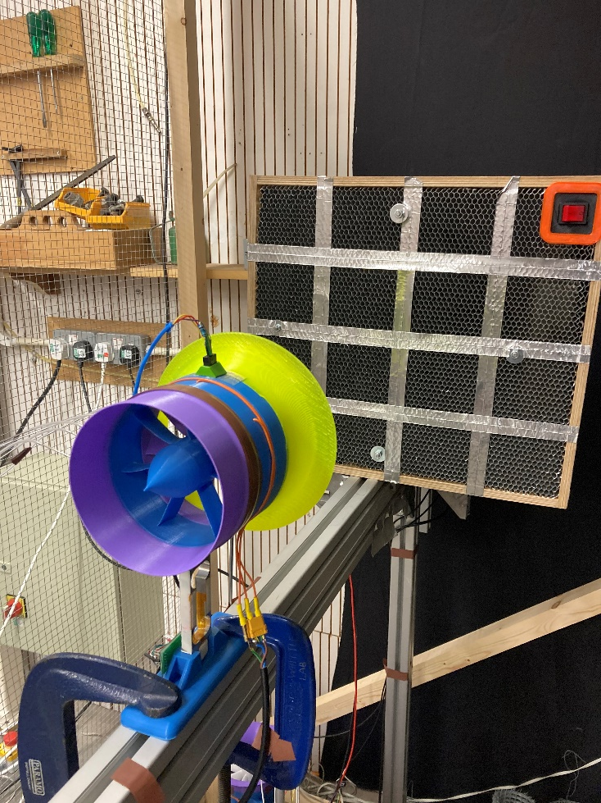
‘Opening the Throttle’
Notes:
Increase mass flow

Slide 22

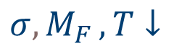
Separation at Inlet
$$A_{E_{DF}}$$
$$σ{, M}_{F},T↓$$
Notes:
Separation
Destabilising moment
Not getting pressure rise, thrust

